Slide 1
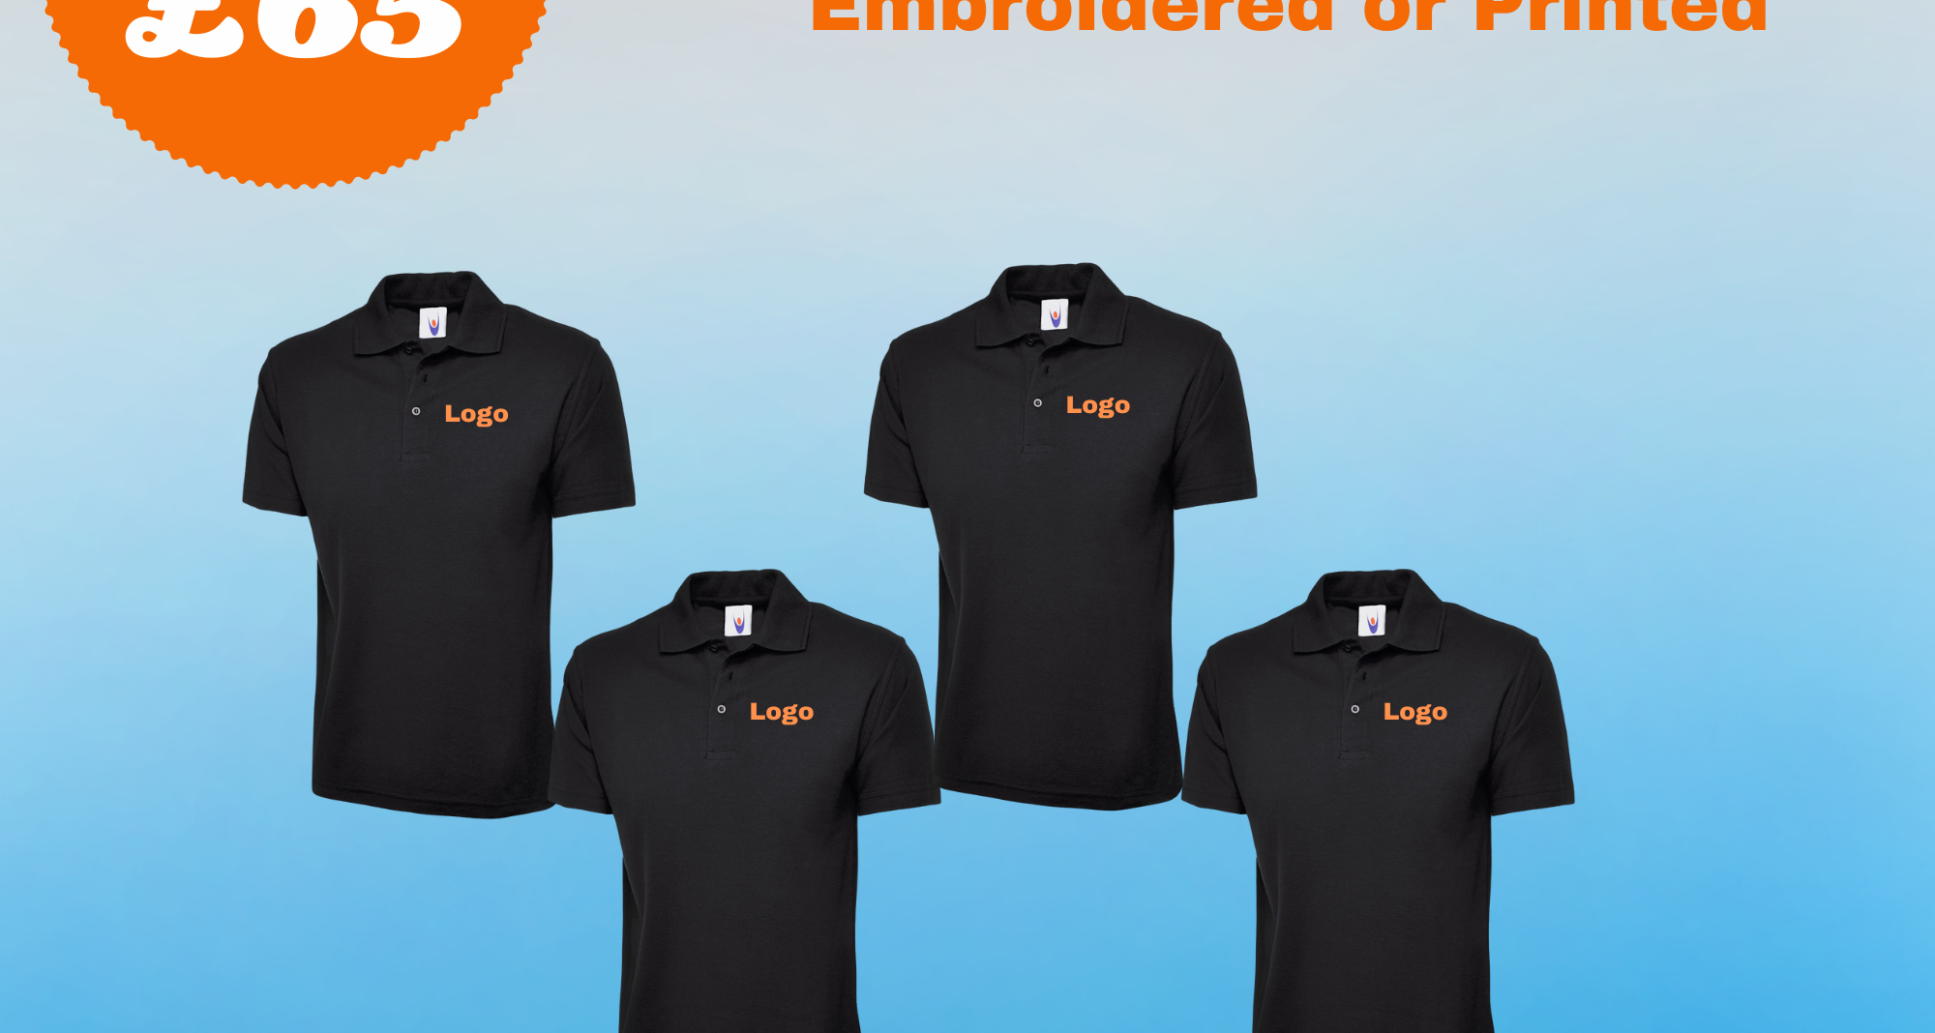
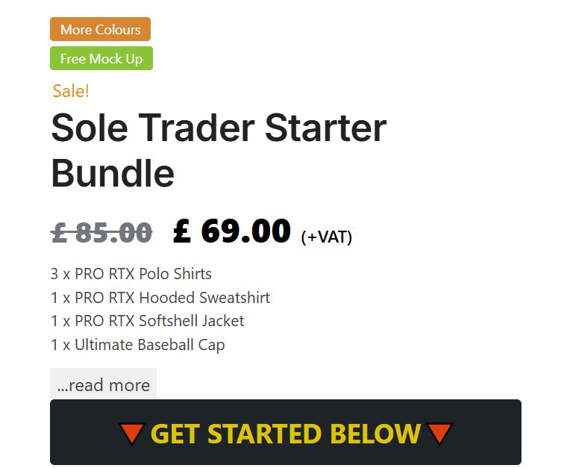
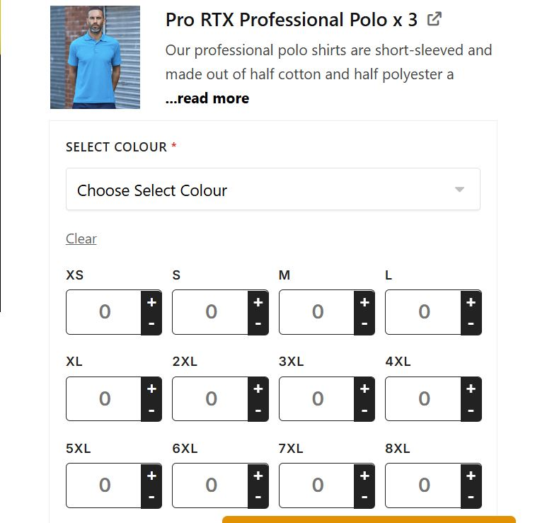
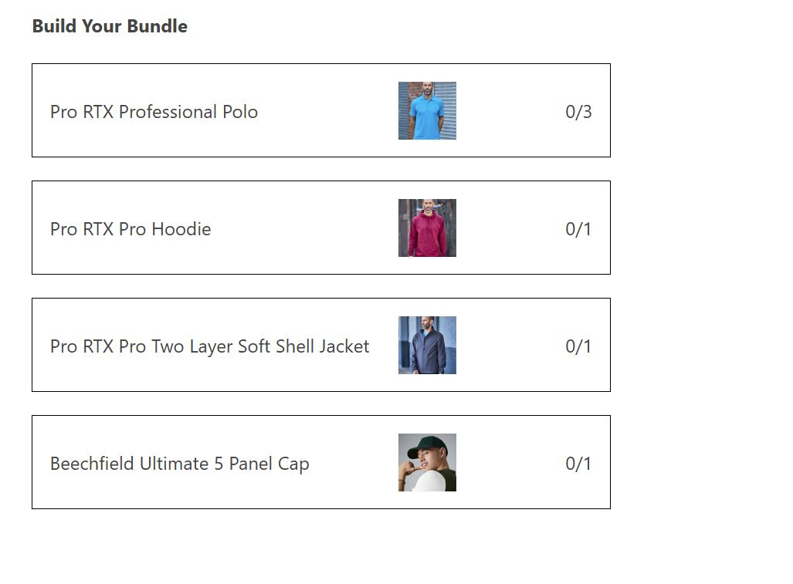

Slide 2
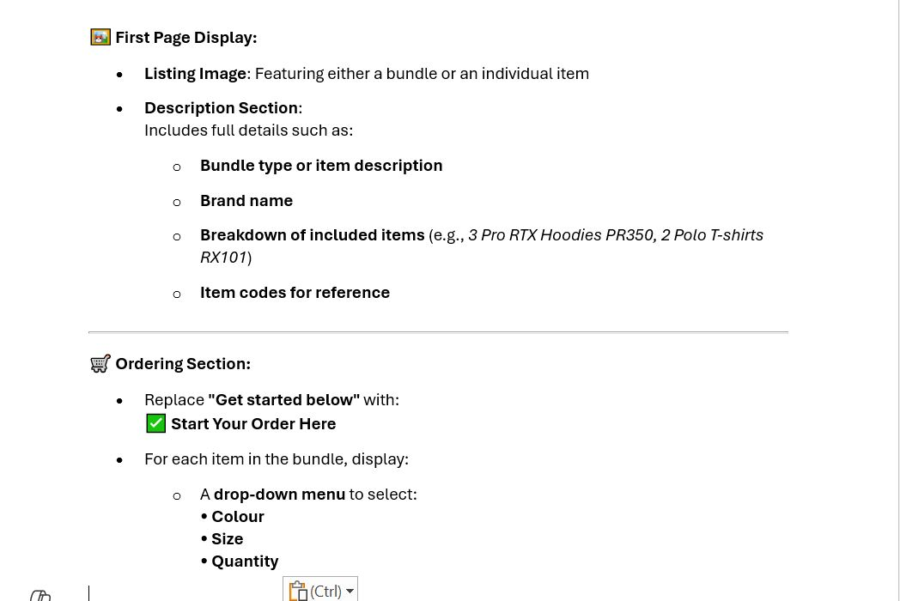

Slide 3
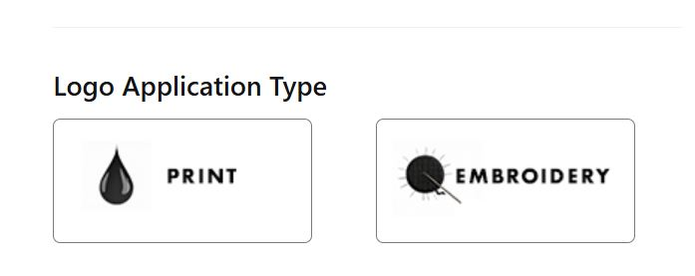
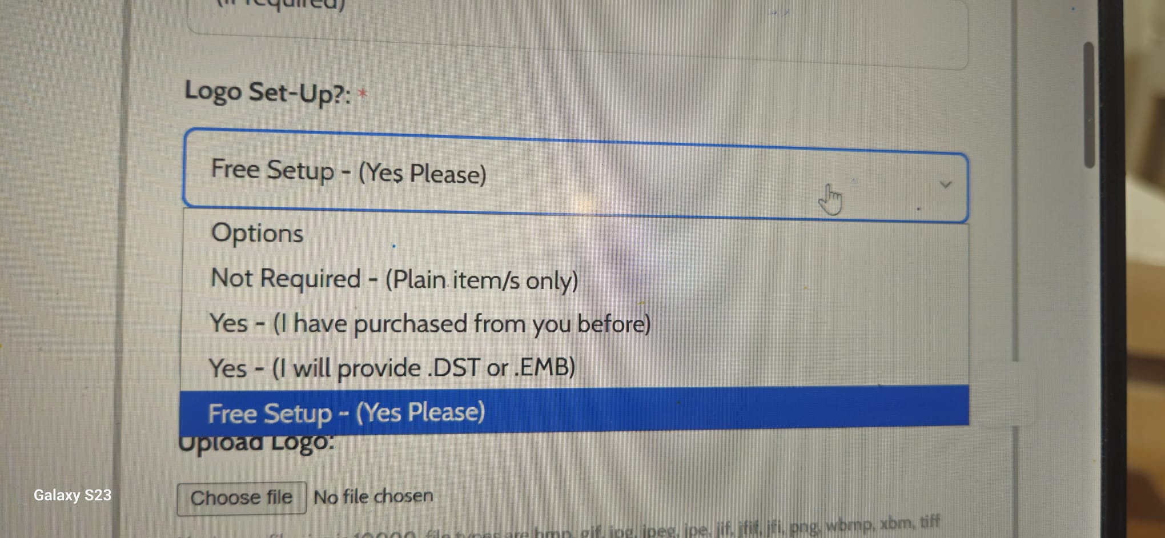

Slide 4
Screenshot Image on slide 3 shows the following –
Format for Logo Application Type (Print or Embroidery)
Once the customer has made the choice there needs to be a drop down for Logo Setup.
If the customer has selected “Print” option in Logo Application type, the following options to show in the dropdown box
  Not Required (Plain items Only)
  Yes (I have purchased from you before)
  Yes (I will provide .PNG, .PDF files)
  Free Setup (Yes Please)
If the customer has selected “Embroidery” as an option in Logo Application type, the following options to show in the dropdown box –
  Not Required – (Plain item/s only)
  Not Required – (I have purchased from you before)
  Not Required – (I will provide .DST or .EMB file)
  Yes : 1–10 items (Lifetime setup fee £15)
  Yes – 10+ items (Free lifetime setup)

Slide 5
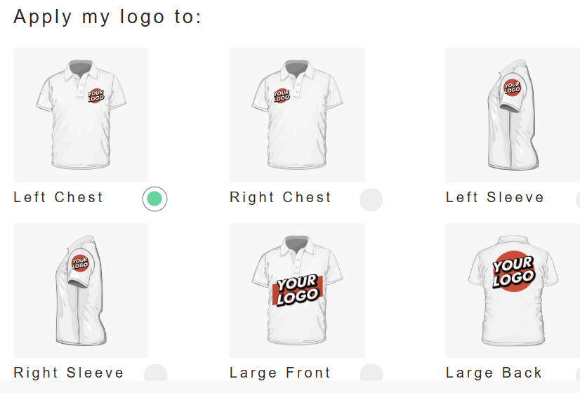
The next step we need after Logo Setup question is Logo Position.
We want the Logo Position where the customer can click on the image to chose the logo placement position. Below image is an example of how we would like this to appear.
* In Bundles, for the logo placement, Left Chest logo is free of charge. The rest of options will be chargeable. However, Printing and Embroidery will have different prices. We will leave with you to see if you can work out.

Slide 6
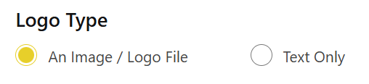
After this we need the Option for “Logo Type” as per the picture below-

Slide 7
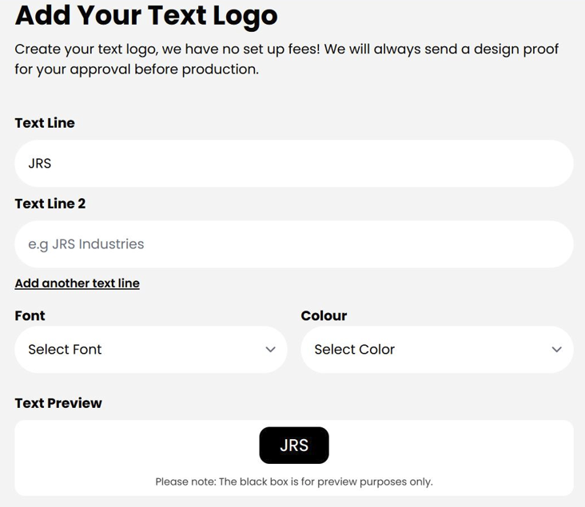
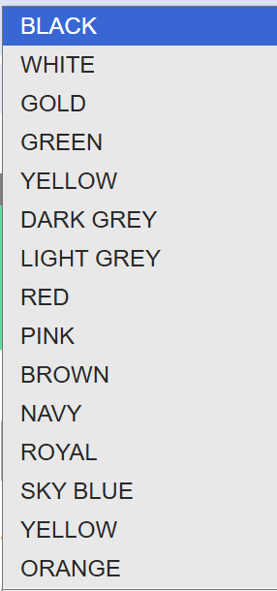
If the customer chooses “Image/Logo File” , Upload option to show up.
If the customer chooses “Text Logo” we would like to have the following dropbox to open up.
In the box we need the options as above picture.
For Font Dropdown box we want only 2 options –
Standard
Italic
For Colour Dropdown box we need the following options –

Slide 8
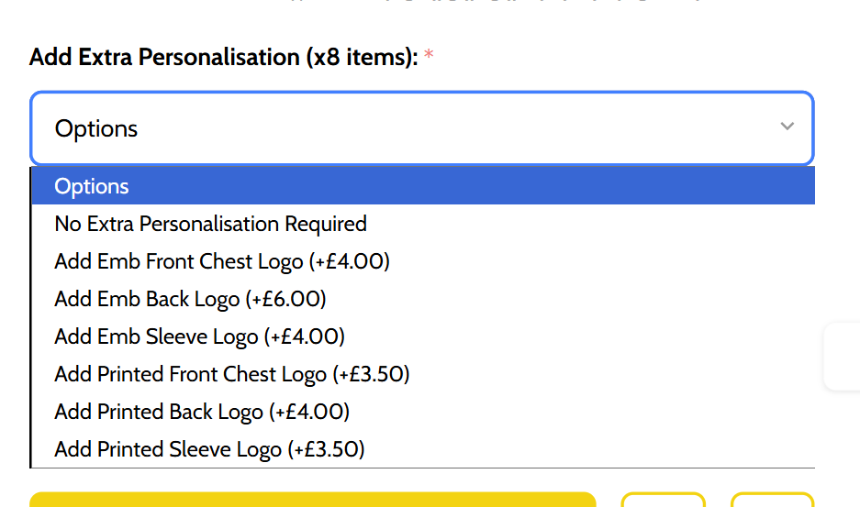
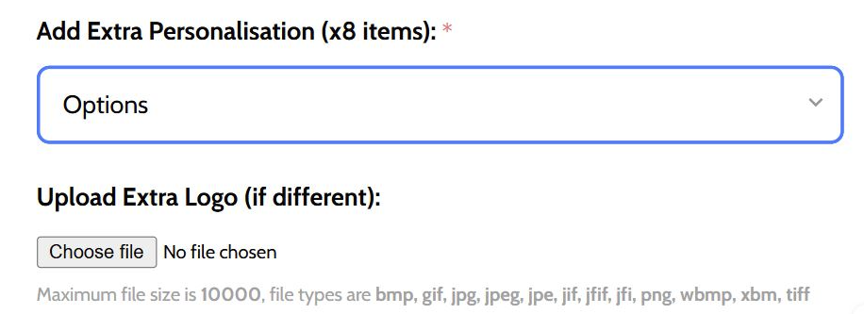
After this we need the option for “Additional Logo”.
If the customer chooses yes, the following dropdown option opens and to upload their Logo if different from the previous one.

Slide 9
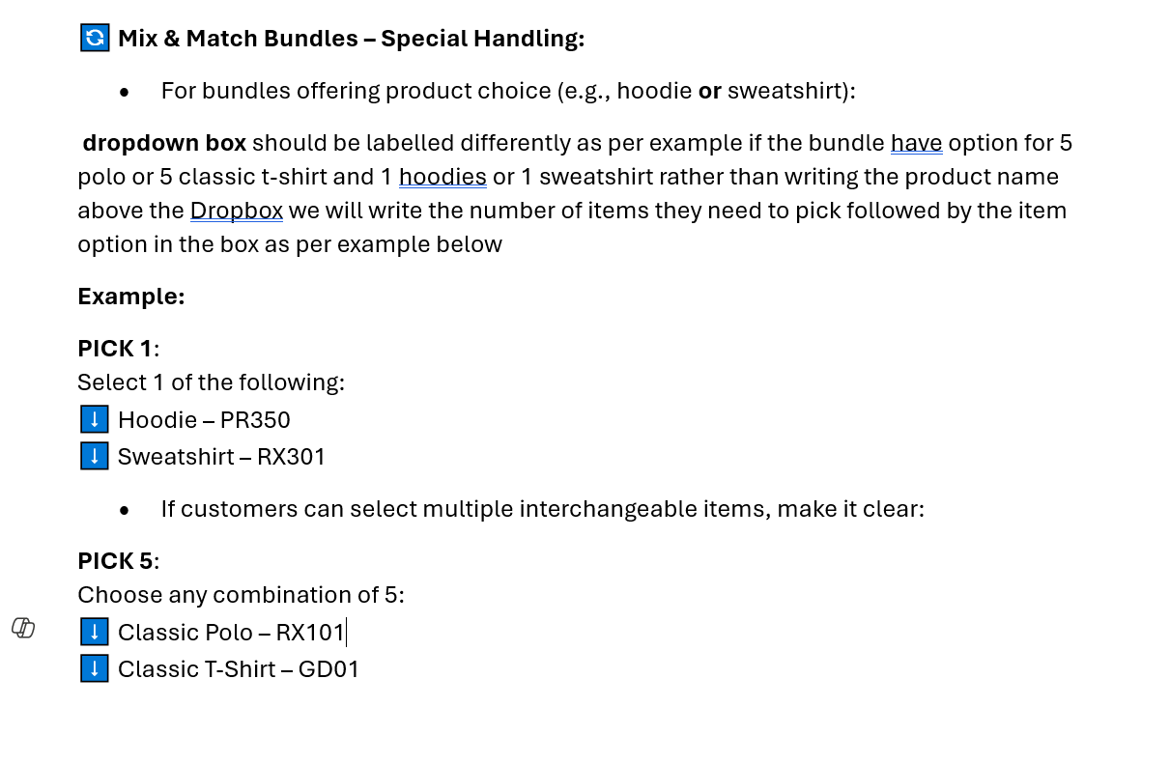
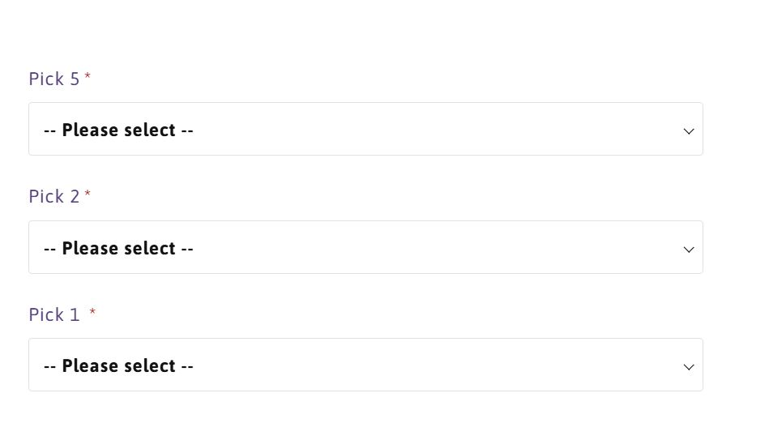

Slide 10
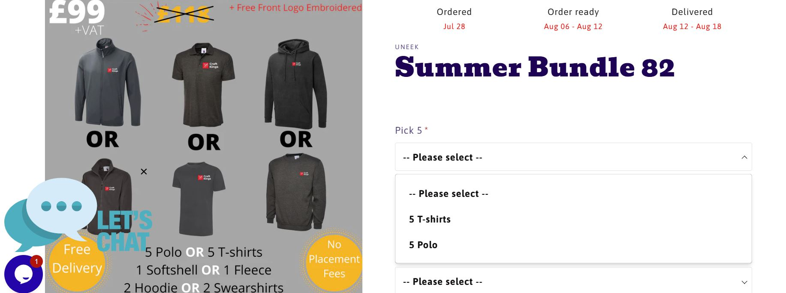
This images are for reference on the previous slide.

Slide 11
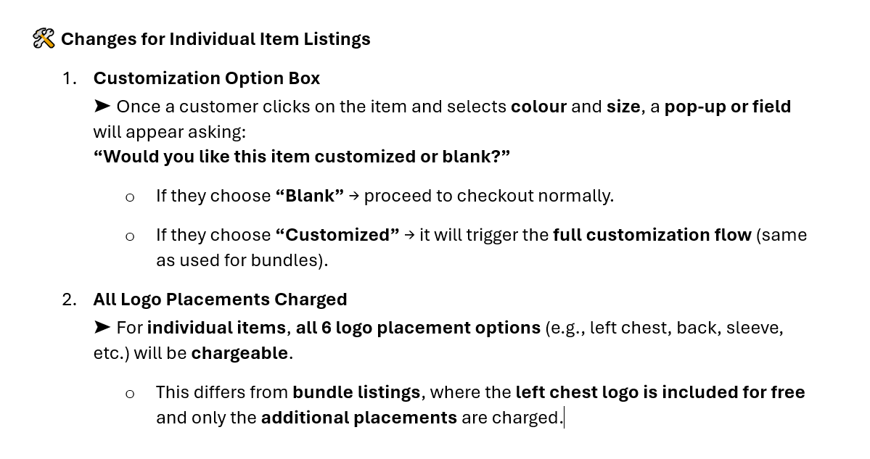

Slide 12
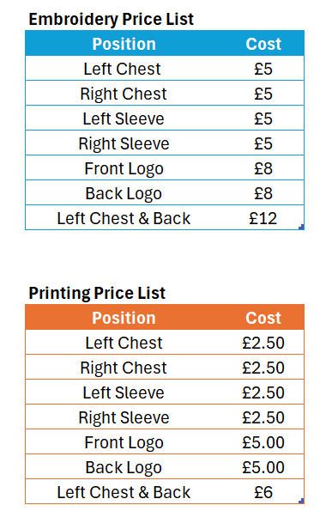
CHARGES
SHIPPING CHARGES - £10 (1-2 Business Days)
Embroidery Charges and Printing charges are different. Please see the table on the left (charges are per product).
For Bundles, Left Chest Logo is Free however any other logo placement apart from left chest the charge will be multiplied to the number of items in the bundle (I.e the customer selected right sleeve logo instead of left chest for his 3 items bundle the charge will be £15, £5 for each item in the bundle).
Any additional logo placements, charges apply as per the table on the left and.

Slide 13
Shops we used as inspiration for our layout if we didn’t explain something properly ;)
https://penguinuniform.com/spring-bundle-2/
https://www.personalisedandprinted.com/sole-trader-starter-bundle/
https://craftkingsltd.co.uk/products/summer-bundle-83
For Craft King please do not check the Regatta bundles as the listings are not aligned with the bundle offer and might be misleading.
NOTES:
The spreadsheet with products list shows All Item codes, Sizes, Brand, Product type, Colours and Prices as per each item code.
You will find some item codes repeated. This is because of differential pricing on the basis of sizes. You will find this mainly with items having sizes from 3XL upwards or even 2XL upwards. Please reflect the same differential pricing on the item listings.
If the pricing is differential due to colour code (White items cheaper than Colour, please use the price for Coloured item for all items including White)

